Slide 1

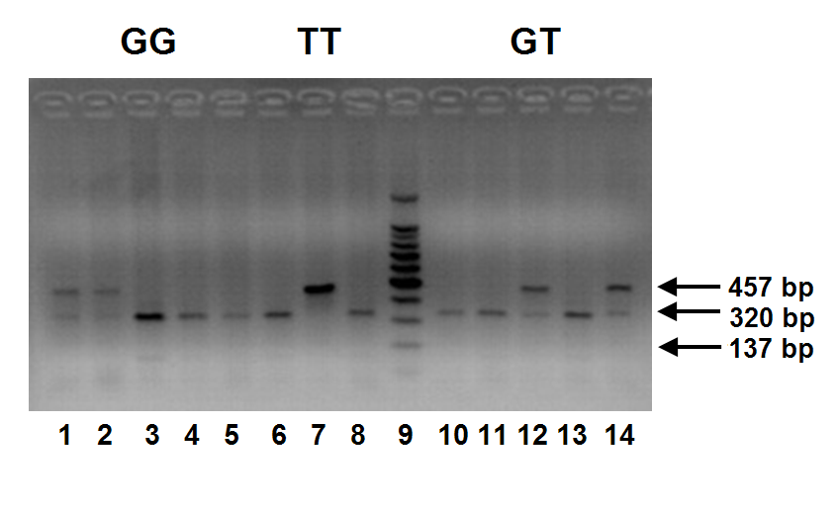
Endothelial nitric oxide synthase (eNOS) gene polymorphism
in a random sample of Egyptian population
M. F. Abdel Rahman¹, S. M. Abdel-Maksoud¹, K. Abou-Aisha² and M. Z. Gad¹
¹Clinical Biochemistry Laboratory, Department of Biochemistry, Faculty of Pharmacy & Biotechnology, German University in Cairo, Cairo, Egypt
²Molecular Biology & Biotechnology Laboratory, Faculty of Pharmacy & Biotechnology, German university in Cairo, Cairo, Egypt.
Background:
.Endothelial nitric oxide synthase (eNOS) is responsible for production of nitric oxide (NO) in endothelial cells. Produced NO is involved in signalling for vasorelaxation, platelet aggregation, proliferation of vascular smooth muscle cells among other mechanisms of cardiovascular homeostasis [1].
Interest in measurement of serum NO concentration is increasing since it has been reported that NO levels are influenced by some diseases including diabetes, heart failure, sepsis, and liver cirrhosis; however little is known about the normal range and the physiological changes of serum NO concentrations in healthy population [2].
Several polymorphisms have been identified in eNOS gene, but Glu298Asp (rs1799983) polymorphism in exon 7 was the only common variation that leads to amino acid substitution in mature protein. In this polymorphism guanine at position 894 is substituted by thymine leading to a change in amino acid at position 298 from glutamate to aspartate. Some studies suggested a functional effect of the Glu298Asp polymorphism [3].
P>0.05
Figure 4: Mean serum NO concentration of different eNOS genotypes in all subjects.
Objectives:
Detect eNOS gene polymorphisms in Egyptian population to be used as a reference for future studies.
Compare eNOS genotypes in Egyptians with those from other populations.
Explore functional correlations of eNOS genotypes with serum levels of NO.
P>0.05
Materials and Methods:
Random unrelated 101 healthy subjects were recruited for study from healthy volunteers attending children cancer hospital, Cairo, Egypt.
eNOS Genotyping:
Genomic DNA was prepared from blood leukocytes. The presence of the missense Glu298Asp variant was determined by polymerase chain reaction–restriction fragment-length polymorphism (PCR-RFLP) analysis. A set of primers was designed to amplify the 457-base pair (bp) fragment encompassing the missense Glu298Asp variant. The PCR fragments were digested with the restriction enzyme Ban II and separated by electrophoresis. The mutant allele (T) has no Ban II cutting site while the wild type allele (G) has a Ban II cutting site producing 2 DNA fragments, 320-base pair (bp) and 137-base pair (bp).
Assay of serum nitric oxide:
Serum NO was determined spectrophotometrically by Griess method.
Figure 5: Mean serum NO concentration of different age groups in male, female and all subjects.
Conclusions:
eNOS genotype distribution pattern in Egyptians is similar to that reported in Caucasians and different from that of Asians and black Africans.
Lack of association between genotypes of eNOS and serum NO concentrations.
Mean serum NO concentration in Egyptian population is 30.26 μM which is close to Turkish population [12], but lower than Asian population [9,13].
No age- and sex-related differences in mean serum NO levels.
In conclusion, the effect of eNOS Glu298Asp polymorphism wasn’t proportional to the serum NO level. Several factors control serum NO level including substrate availability, concentration of ADMA, eNOS signaling, tetrahydrobiopterin availability and destruction of NO by free radicals.
Results:
Future Research:
To investigate eNOS Glu298Asp SNP in Egyptian cardiovascular patients, to assess serum levels of NO in different health and disease states and to explore eNOS expression in endothelial cell lines under the influence of different drugs.
Figure 1: Representative of 2% agarose gel electrophoresis on Ban II RFLP of e-NOS gene. Lane 3, homozygous of GG; lane 7, homozygous of TT; lane 12, heterozygous of GT.
References:
Strijdom H, Chamane N, Lochner A (2009) Nitric oxide in the cardiovascular system: a simple molecule with complex actions. Cardiovasc J Afr, 20, 303-10.
Ghasemi A, Zahedi Asl S, Mehrabi Y, Saadat N, Azizi F (2008) Serum nitric oxide metabolite levels in a general healthy population: relation to sex and age. Life Sci, 83, 326-31.
Hingorani AD, Liang CF, Fatibene J, et al. (1999) A common variant of the endothelial nitric oxide synthase (Glu298-->Asp) is a major risk factor for coronary artery disease in the UK. Circulation, 100, 1515-20.
El-Kilany GEN, Nayel E, Hazzaa S (2004) Nitric oxide synthase gene G298 allele. Is it a marker for microvascular angina in hypertensive patients? Cardiovascular Radiation Medicine, 5, 113–118.
Monti LD, Barlassina C, Citterio L, et al. (2003) Endothelial nitric oxide synthase polymorphisms are associated with type 2 diabetes and the insulin resistance syndrome. Diabetes, 52, 1270-5.
Akomolafe A, Lunetta KL, Erlich PM, et al. (2006) Genetic association between endothelial nitric oxide synthase and Alzheimer disease. Clin Genet, 70, 49-56.
Walch K, Kolbus A, Hefler-Frischmuth K (2008) Polymorphisms of the endothelial nitric oxide synthase gene in premenopausal women with polycystic ovary syndrome. Maturitas, 61, 256-9.
Kato N, Sugiyama T, Morita H, et al. (1999) Lack of evidence for association between the endothelial nitric oxide synthase gene and hypertension. Hypertension, 33, 933-6.
Moon J, Yoon S, Kim E, Shin C, Jo SA, Jo I (2002) Lack of evidence for contribution of Glu298Asp (G894T) polymorphism of endothelial nitric oxide synthase gene to plasma nitric oxide levels. Thromb Res, 107, 129-34.
Nishevitha NS, Angeline T, Jeyaraj N (2009) Endothelial nitric oxide synthase (eNOS) Glu298-->Asp polymorphism (G894T) among south Indians. Indian J Med Res, 129, 68-71.
Hillermann R, Carelse K, Gebhardt GS (2005) The Glu298Asp variant of the endothelial nitric oxide synthase gene is associated with an increased risk for abruptio placentae in pre-eclampsia. The Japan Society of Human Genetics, 50, 415–419.
Afrasyap L, Ozturk G (2004) NO level and endothelial NO synthase gene polymorphism (Glu298Asp) in the patients with coronary artery disease from the Turkish population. Acta Biochim Biophys Sin (Shanghai), 36, 661-6.
Higashino H, Miya H, Mukai H, Miya Y (2007) Serum nitric oxide metabolite (NO(x)) levels in hypertensive patients at rest: a comparison of age, gender, blood pressure and complications using normotensive controls. Clin Exp Pharmacol Physiol, 34, 725-31.
Figure 2: Genotype distribution of eNOS Glu298Asp.
Figure 3: Allele frequencies of eNOS Glu298Asp.
Population | GG % | GT % | TT % | G% | T%
Present study | 58.4 | 33.7 | 7.9 | 75.25 | 24.75
Egypt Tanta (n=10) [4] | 50 | 40 | 10 | 70 | 30
Caucasians living in Italy [5] | 46.4 | 39.6 | 14 | 66.2 | 33.8
Caucasians (Multi-institutional study) [6] | 48 | 43 | 9 | 69.5 | 30.5
Caucasians living in Austria [7] | 50.3 | 41.5 | 8.2 | 71.05 | 28.95
Japanese [8] | 84.4 | 14.8 | 0.8 | 91.8 | 8.2
Korean [9] | 79.6 | 19.5 | 0.9 | 89.35 | 10.65
South Indians [10] | 74.3 | 25.7 | 0 | 87.15 | 12.85
South Africans [11] | 78.6 | 19.1 | 2.4 | 88.1 | 11.9
African Americans [6] | 68 | 30 | 1 | 83 | 17
Table 1: Comparison between eNOS genotype distribution and allele frequency in the present study and other different populations
Notes:
Radiation inducible gene expression delivered by adenoviral vectors
T.v.Lukowicz§*, M.Anton*, B.Gänsbacher*, M.Molls§, F.Würschmidt§
§Klinik für Strahlentherapie & Radiologische Onkologie und *Institut für Experimentelle Onkologie & Therapieforschung der TU München, Klinikum r.d.Isar, München
Objective: Construction and testing of a replication defective adenovirus expressing a reporter gene (EGFP) or a suicide gene (HSV-TK) under control of the radiation-inducible promoter of the mEgr-1 gene.
Background:
There are several strategies in gene therapy of cancer: 1) substitution of mutated genes 2) induction of immune response against tumor cells and 3) delivery of cytotoxic genes to tumor cells. Cytotoxic genes can be either delivered directly or a suicide gene strategy can be chosen, in which a gene for a metabolic enzyme is transduced into the tumor cells. This enzyme specifically catalyses the conversion of a non-toxic pro-drug into the toxic drug. Gene delivery can be achieved using either viral or non-viral vectors. A mayor obstacle in gene therapy is the suboptimal transduction efficiency, since only a small percentage of cells in a tumor are transduced.
In order to combine gene therapy and radiotherapy, this project aims at killing tumour cells by transducing them with suicide genes. A radiation-inducible promoter (from murine Early growth response 1-gene, EGR-1) is used to regulate the expression of a suicide gene (Herpes simplex virus-thymidine kinase, HSV-TK). The radiation-inducibility of the promoter results in a tight spatial and temporal control of therapeutic gene expression. Delivering the construct by an adenoviral vector results in efficient gene transduction.
Human adenovirus serotype 5 (Figure 1)
- widely studied, well characterized
- easy to generate and manipulate
- relatively stable, can be obtained in high titers
- broad host range in vivo and in vitro
- high infectivity even in non-dividing cells
- no intergration into host cell genome required, genotoxicity stays low
Egr-1 Promoter: A minimal promoter construct extending from –425 to +65bp of the murine Egr-1 region was used. This promoter region contains six CArG or serum response elements, responsible for the increased transcription after irradiation. Reactive oxygen intermediates, which arise during irradiation, target those CArG elements and mediate their activation.
Enhanced Green Fluorescent Protein (EGFP): marker protein (Aequorea victoria, modified, Clontech), with excitation maximum of 488 nm and emmission maximum of 507 nm.
HSV-TK & Ganciclovir (GCV): The prodrug ganciclovir is converted into a cytotoxic agent by HSV-TK.
Cell lines: - rhabdomyosarcoma R1H of the rat
- human lung carcinoma cell line A549
Infection: Cells were infected with 100μl of supernatant or at a multiplicity of infection (MOI) of 25.
Irradiation: Cells were plated in tissue culture flasks, infected and 24 hours later irradiated with 6 MeV photons. Cells were kept under ambient conditions and room temperature during irradiation. Single doses of 1, 2, 4, 6, and 8 Gy were given. Control cells were either infected or not infected and sham irradiated under the same conditions as irradiated cells.
Gene expression was analyzed by fluorescence microscopy.
Results:
Figure 1
Figure 3: Analysis of viral DNA. Restriction enzyme digest with PvuI and subsequent gel electrophoresis
Conclusions: The radiation inducible promoter and enhancer of the EGR-1 gene was successfully introduced into the E1 region of an Ad vector, providing us with a tool that allows control of gene expression of any cDNA by irradiation. Radiation inducibility of EGFP expression was detected at 4 and 6 Gy.
Future research is directed towards optimization of adenoviral constructs to further reduce gene expression in the absence of radiation.
Guanosine
Ganciclovir
Materials & Methods:
Construction of adenoviral vector (Figure 2): The cDNA encoding EGFP or HSV-TK, respectively, were placed in the left end of the adenovirus (Ad) genome under control of the EGR-1 promoter, followed by an SV40 polyadenylation signal.
Figure 4: Radiation inducibility
of EGFP expression. R1H cells
were not infected, but irradiated at
6 Gy (A,B), infected and irradiated
with 0Gy (C,D) or 6Gy (E,F);
Fluorescence: excitation at - nm ,
(200x): A, C, E; bright field ( 200x):
B, D, F;
A
Figure 5: Dose dependent expression of EGFP. R1H cells were infected at
MOI 25 and irradiated at indicated doses. Fluorescence at 200x.
Figure 2
1 Gy
0 Gy
2 Gy
4 Gy
8 Gy
B
C
D
E
F

