Slide 1

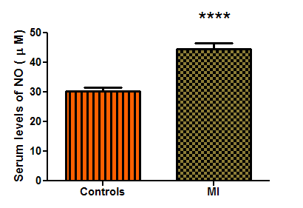
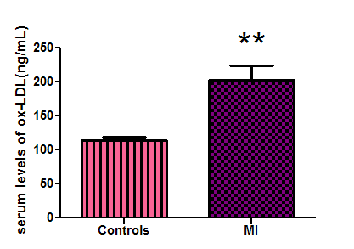
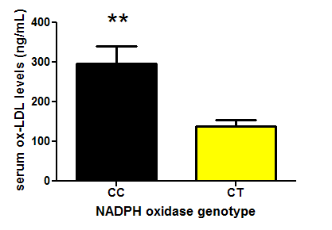
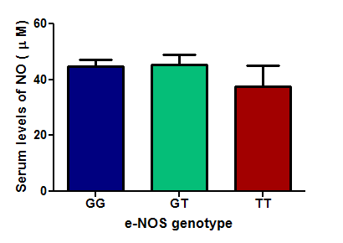
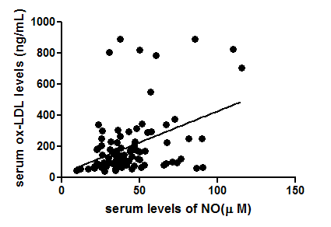
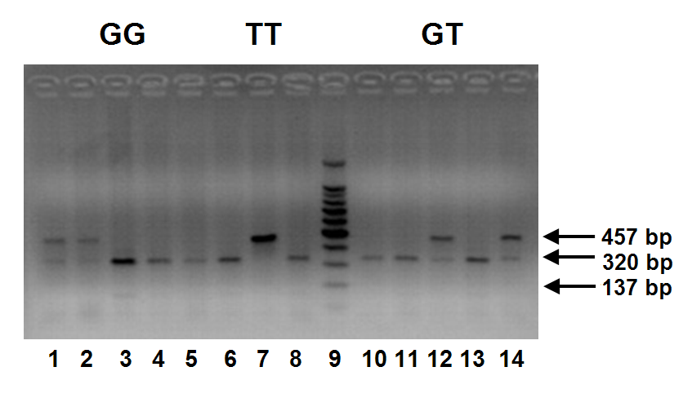
Contribution of NAD(P)H Oxidase and eNOS Gene Polymorphism in the Predisposition of Early Onset Acute Myocardial Infarction
Ingy M. Hashad¹, Gamal Shaaban², Mohamed F. Abdel Rahman¹, Mohamed Z. Gad¹
¹ German University in Cairo, ² National Heart Institute , Giza, Egypt
Background:
Myocardial infarction (MI) is considered as one of the leading causes of death worldwide. However, the molecular mechanisms for the pathogenesis of MI remain to be fully elucidated [1].
NAD(P)H oxidase is a multi-subunit enzyme complex. The p22 phox subunit is required for oxidase activity in smooth muscle cells and is expressed in human coronary arteries. Recent interest has focused on possible association of polymorphisms in the CYBA gene, which encodes p22 phox, with atherosclerosis. The C242T polymorphism results in a substitution of Tyr for His at residue 72 of p22 phox, leading to speculation that this polymorphism may modulate enzyme activity by affecting heme binding. Recent data suggest that the C242T allele is associated with increased progression of coronary artery disease. However, the relationship between the C242T polymorphism and vascular NAD(P)H oxidase in human blood vessels remains unknown [2].
Endothelial nitric oxide synthase (eNOS) is encoded by the eNOS gene and is responsible for the synthesis of nitric oxide (NO) from L-arginine in endothelial cells. The eNOS Glu (E) → Asp (D) amino acid polymorphism at position 298 has been linked to the risk of early onset acute MI [3].
Figure (5): NADPH oxidase genotype distribution in MI patients as compared to controls
Figure (6): NADPH oxidase allele distribution in MI patients as compared to controls
Objectives :
44.66
202.33
Investigate the contribution of the C242T polymorphism of the p22 phox gene of NADPH oxidase as well as the Glu298Asp polymorphism of eNOS gene in the predisposition of early onset MI in Egyptian patients.
Define the contribution of oxidative stress in the development of early onset MI.
Correlate these genotypes with biochemical markers of oxidative stress.
30.26
113.48
Materials and Methods :
Figure (7): Serum levels of NO in MI patients versus controls
Figure (8): Serum levels of ox-LDL in MI patients versus controls
The study subjects consisted of 104 MI patients and 101 aged matched healthy volunteers.
Genotyping:
Genomic DNA was prepared from blood leukocytes. For the eNOS gene, the presence of the missense Glu298Asp variant was determined by polymerase chain reaction–restriction fragment-length polymorphism (PCR-RFLP) analysis. The resulting 457-bpPCR product was digested with restriction enzyme Ban II. The mutant allele (T) has no Ban II cutting site while the wild type allele (G) has a Ban II cutting site producing 2 DNA fragments, 320-bp and 137-bp.
With regard to p22 phox gene of NADPH oxidase, the DNA fragment containing C242T polymorphic site was amplified from genomic DNA by PCR-RFLP then PCR product was digested with Rsa I. C→T mutation at nucleotide 242 creates an Rsa I digestion site, which digests 348-bp fragment into 160- and 188-bp fragments.
Biochemical markers:
Serum levels of oxidized low density lipoprotein (ox-LDL) were determined by ELISA technique , while serum NO levels were measured calorimetrically by Griess method.
297.26
44.65
45.44
37.63
137.95
Figure (9): Correlation between NADPH oxidase genotype distribution and serum levels of ox-LDL in MI patients
Figure (10): Correlation between e-NOS genotype distribution and serum levels of NO in MI patients
Results:
r = 0.337 , P = 0.001
Figure (1) : Representative of 2% agarose gel electrophoresis on Ban II RFLP of e-NOS gene. Lane 3, homozygous of GG; lane 7, homozygous of TT; lane 12, heterozygous of GT.
Figure (2) : Representative of 2% agarose gel electrophoresis on Rsa I RFLP of p22 phox gene. Lane 1, heterozygote of TC; lanes 2 and 3, homozygotes of CC; lane 4, homozygote of TT
Figure (9): Correlation between serum levels of NO versus serum levels of ox-LDL in MI patients
Conclusions:
Our observations suggest that C242T polymorphism of the p22 phox gene of NAD(P)H oxidase may reduce susceptibility to MI and is a novel genetic marker that has a protective effect on coronary risk while no significant association was observed between the Glu298Asp polymorphism of eNOS gene and incidence of MI in this Egyptian population.
Future Research:
To evaluate the exact causal relationships between the studied gene polymorphisms and the corresponding markers for oxidative stress , the study of gene expression and protein production is of value.
References:
(1) Tsutsui M, Nakata S, Shimokawa H, et al. (2008). Spontaneous Myocardial Infarction and Nitric Oxide Synthase.TCM, 18, 275-279
(2) Guzik TJ, West NEJ, Black E, et al.(2000). Functional Effect of the C242 T Polymorphism in the NADPH oxidase p22 phox Gene on Vascular Superoxide Production in Atherosclerosis. Circulation, 102, 1744-1747
(3) Morray B, Goldenberg I, Moss AJ, et al. (2007). Polymorphisms in Paraoxonase and Endothelial Nitric Oxide Synthase Genes and the Risk of Early Onset Myocardial Infarction. Am J Cardiol, 99, 1100-1105
Figure (3): e-NOS genotype distribution in MI patients as compared to controls
Figure (4): e-NOS allele distribution in MI patients as compared to controls
Notes:
Radiation inducible gene expression delivered by adenoviral vectors
T.v.Lukowicz§*, M.Anton*, B.Gänsbacher*, M.Molls§, F.Würschmidt§
§Klinik für Strahlentherapie & Radiologische Onkologie und *Institut für Experimentelle Onkologie & Therapieforschung der TU München, Klinikum r.d.Isar, München
Objective: Construction and testing of a replication defective adenovirus expressing a reporter gene (EGFP) or a suicide gene (HSV-TK) under control of the radiation-inducible promoter of the mEgr-1 gene.
Background:
There are several strategies in gene therapy of cancer: 1) substitution of mutated genes 2) induction of immune response against tumor cells and 3) delivery of cytotoxic genes to tumor cells. Cytotoxic genes can be either delivered directly or a suicide gene strategy can be chosen, in which a gene for a metabolic enzyme is transduced into the tumor cells. This enzyme specifically catalyses the conversion of a non-toxic pro-drug into the toxic drug. Gene delivery can be achieved using either viral or non-viral vectors. A mayor obstacle in gene therapy is the suboptimal transduction efficiency, since only a small percentage of cells in a tumor are transduced.
In order to combine gene therapy and radiotherapy, this project aims at killing tumour cells by transducing them with suicide genes. A radiation-inducible promoter (from murine Early growth response 1-gene, EGR-1) is used to regulate the expression of a suicide gene (Herpes simplex virus-thymidine kinase, HSV-TK). The radiation-inducibility of the promoter results in a tight spatial and temporal control of therapeutic gene expression. Delivering the construct by an adenoviral vector results in efficient gene transduction.
Human adenovirus serotype 5 (Figure 1)
- widely studied, well characterized
- easy to generate and manipulate
- relatively stable, can be obtained in high titers
- broad host range in vivo and in vitro
- high infectivity even in non-dividing cells
- no intergration into host cell genome required, genotoxicity stays low
Egr-1 Promoter: A minimal promoter construct extending from –425 to +65bp of the murine Egr-1 region was used. This promoter region contains six CArG or serum response elements, responsible for the increased transcription after irradiation. Reactive oxygen intermediates, which arise during irradiation, target those CArG elements and mediate their activation.
Enhanced Green Fluorescent Protein (EGFP): marker protein (Aequorea victoria, modified, Clontech), with excitation maximum of 488 nm and emmission maximum of 507 nm.
HSV-TK & Ganciclovir (GCV): The prodrug ganciclovir is converted into a cytotoxic agent by HSV-TK.
Cell lines: - rhabdomyosarcoma R1H of the rat
- human lung carcinoma cell line A549
Infection: Cells were infected with 100μl of supernatant or at a multiplicity of infection (MOI) of 25.
Irradiation: Cells were plated in tissue culture flasks, infected and 24 hours later irradiated with 6 MeV photons. Cells were kept under ambient conditions and room temperature during irradiation. Single doses of 1, 2, 4, 6, and 8 Gy were given. Control cells were either infected or not infected and sham irradiated under the same conditions as irradiated cells.
Gene expression was analyzed by fluorescence microscopy.
Results:
Figure 1
Figure 3: Analysis of viral DNA. Restriction enzyme digest with PvuI and subsequent gel electrophoresis
Conclusions: The radiation inducible promoter and enhancer of the EGR-1 gene was successfully introduced into the E1 region of an Ad vector, providing us with a tool that allows control of gene expression of any cDNA by irradiation. Radiation inducibility of EGFP expression was detected at 4 and 6 Gy.
Future research is directed towards optimization of adenoviral constructs to further reduce gene expression in the absence of radiation.
Guanosine
Ganciclovir
Materials & Methods:
Construction of adenoviral vector (Figure 2): The cDNA encoding EGFP or HSV-TK, respectively, were placed in the left end of the adenovirus (Ad) genome under control of the EGR-1 promoter, followed by an SV40 polyadenylation signal.
Figure 4: Radiation inducibility
of EGFP expression. R1H cells
were not infected, but irradiated at
6 Gy (A,B), infected and irradiated
with 0Gy (C,D) or 6Gy (E,F);
Fluorescence: excitation at - nm ,
(200x): A, C, E; bright field ( 200x):
B, D, F;
A
Figure 5: Dose dependent expression of EGFP. R1H cells were infected at
MOI 25 and irradiated at indicated doses. Fluorescence at 200x.
Figure 2
1 Gy
0 Gy
2 Gy
4 Gy
8 Gy
B
C
D
E
F

